Slide 1
Customer Segmentation Analysis Project ID- PTID-CDA-AUG-23-025

Slide 2
Task:
1. How is the shopping distribution according to gender?
2. Which gender did we sell more products to?
3. Which gender generated more revenue?
4. Distribution of purchase categories relative to other columns?
5. How is the shopping distribution according to age?
6. Which age cat did we sell more products to?
7. Which age cat generated more revenue?
8. Distribution of purchase categories relative to other columns?
9. Does the payment method have a relation with other columns?
10. How is the distribution of the payment method?
11. Visualize the data using Tableau /Power BI and derive
insights and give your inputs/suggestions to the company.

Slide 3
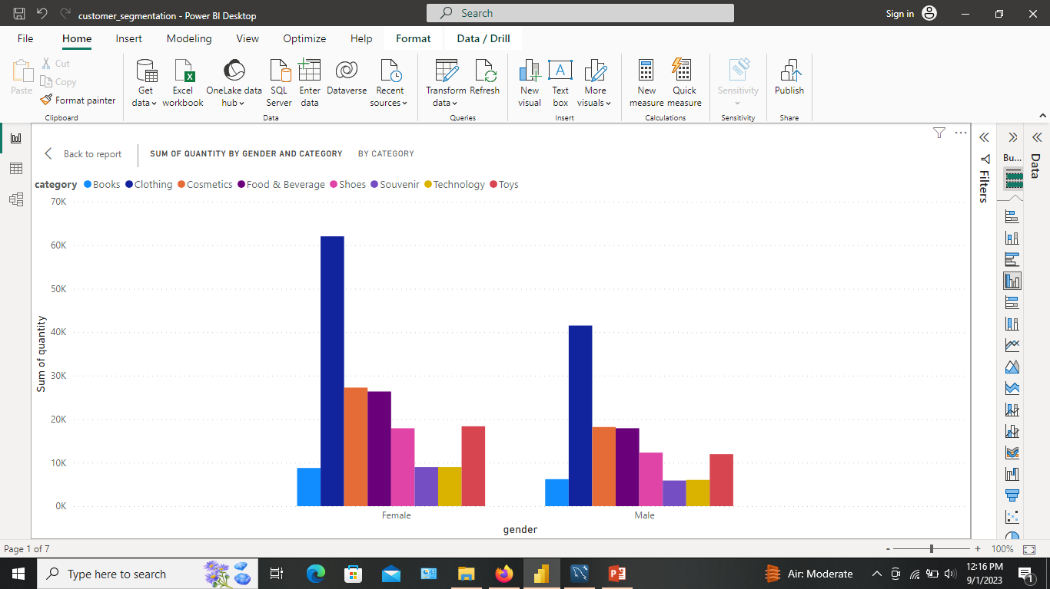
1.How is the shopping distribution according to gender?

Slide 4
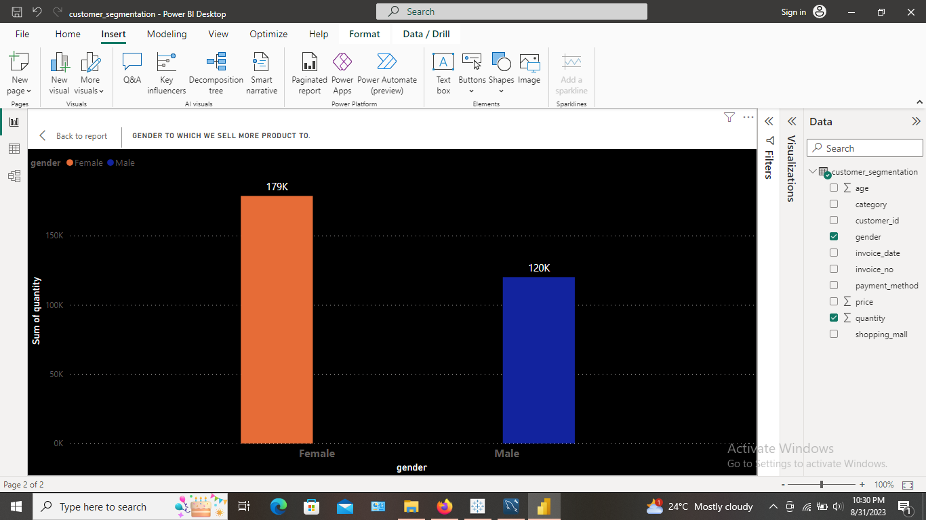
2. Which gender did we sell more products to?
We have sold more products to the Female. Nearly 180k.

Slide 5
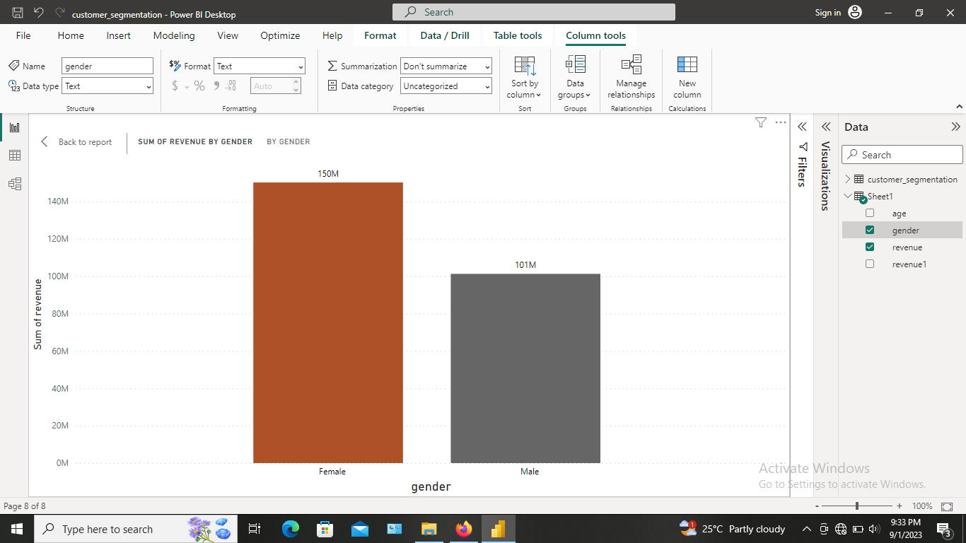
3. Which gender generated more revenue?
Gender Female generated more revenue= 150M.

Slide 6
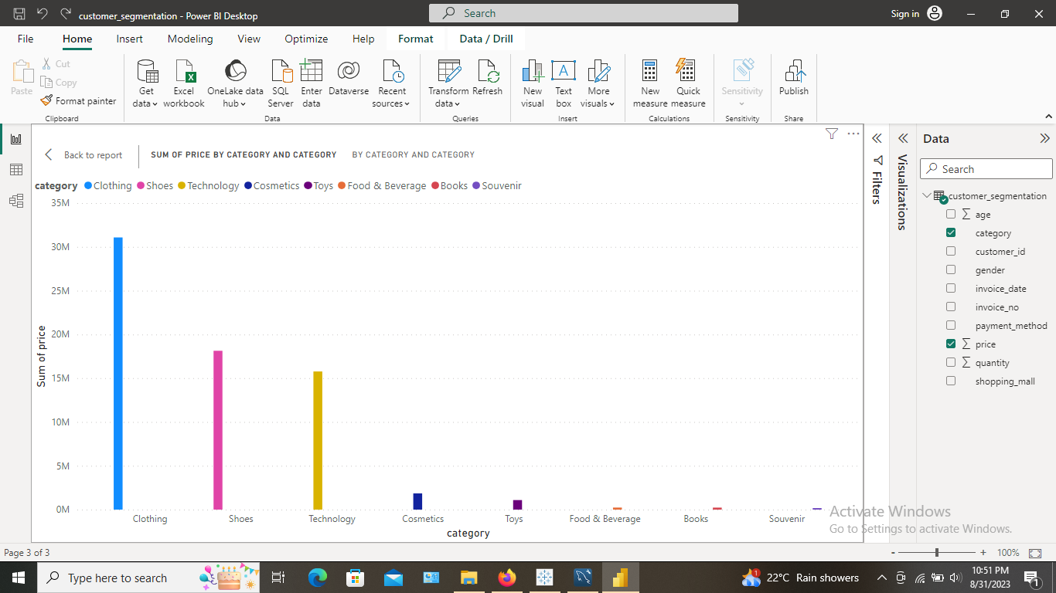
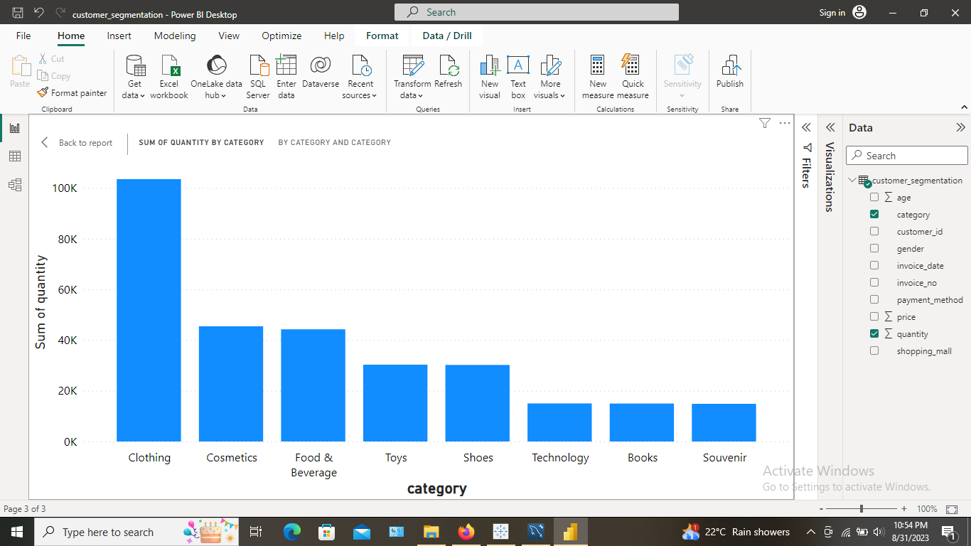
4. Distribution of purchase categories relative to other columns?

Slide 7
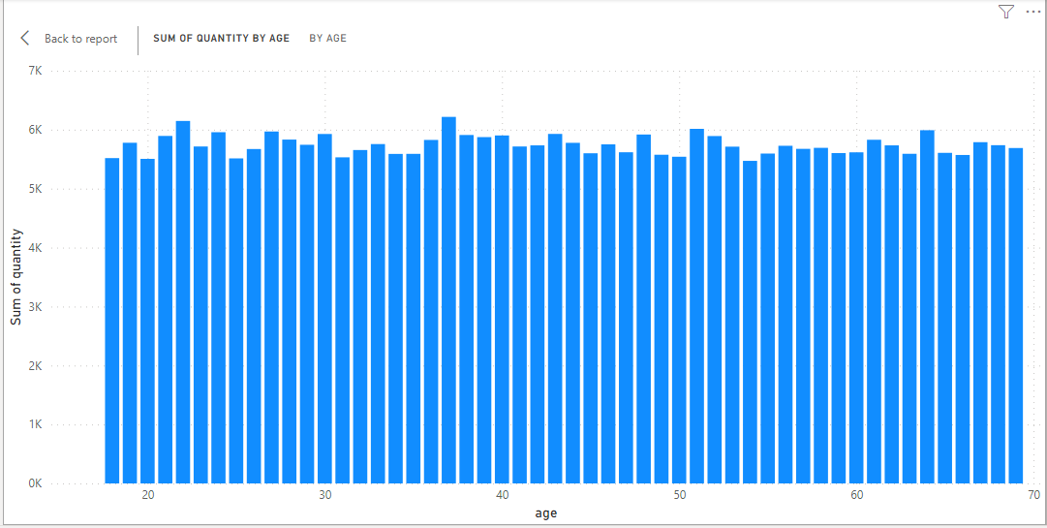
5. How is the shopping distribution according to age?

Slide 8
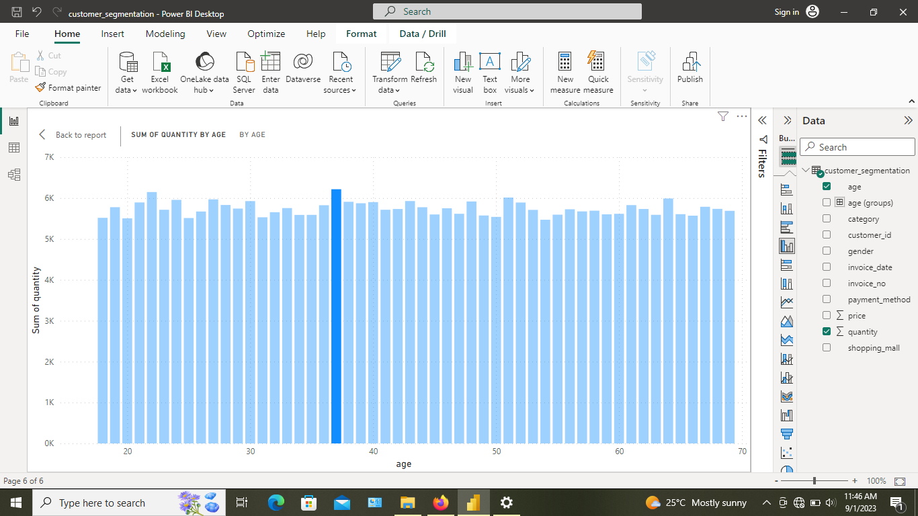
6. Which age cat did we sell more products to?
Age category we sell more product is 37.

Slide 9
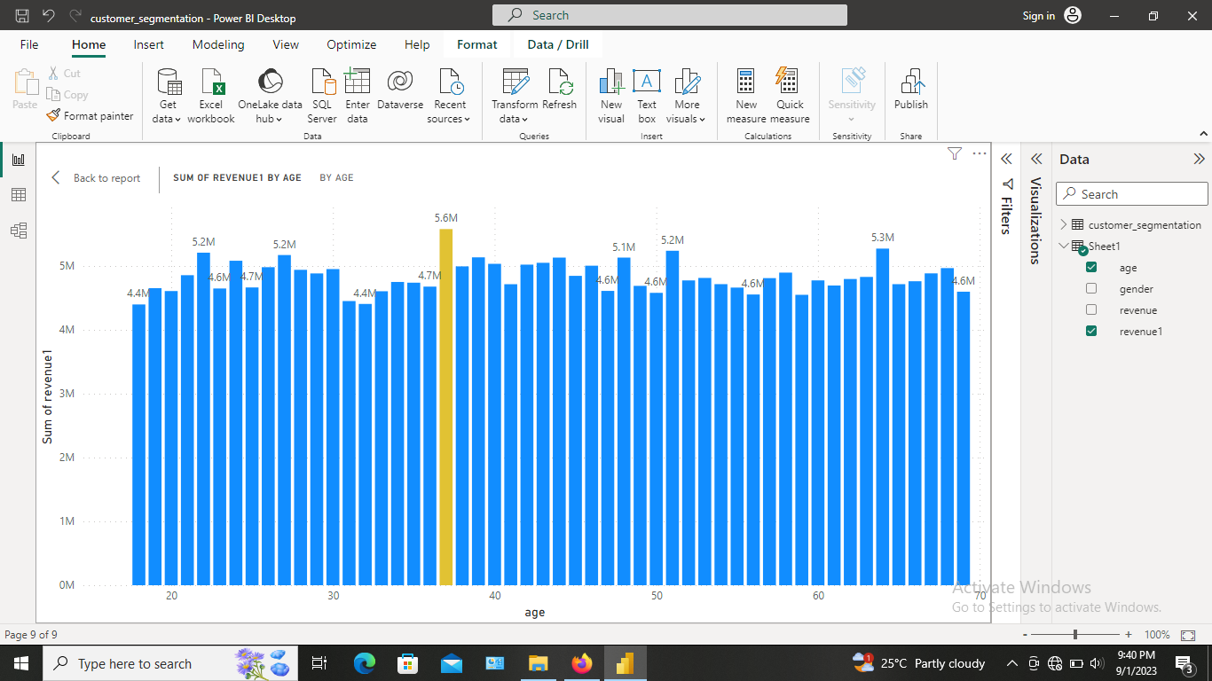
7. Which age cat generated more revenue?
Age category generated more revenue is 37.

Slide 10
8. Distribution of purchase categories relative to other columns?
Same as task no. 4

Slide 11
9. Does the payment method have a relation with other columns?
Yes, we can establish a relation between payment method and categories of products we sell.
We can fetch insight that, which category of product is sold by using specific payment method. As mentioned in task no. 10.

Slide 12
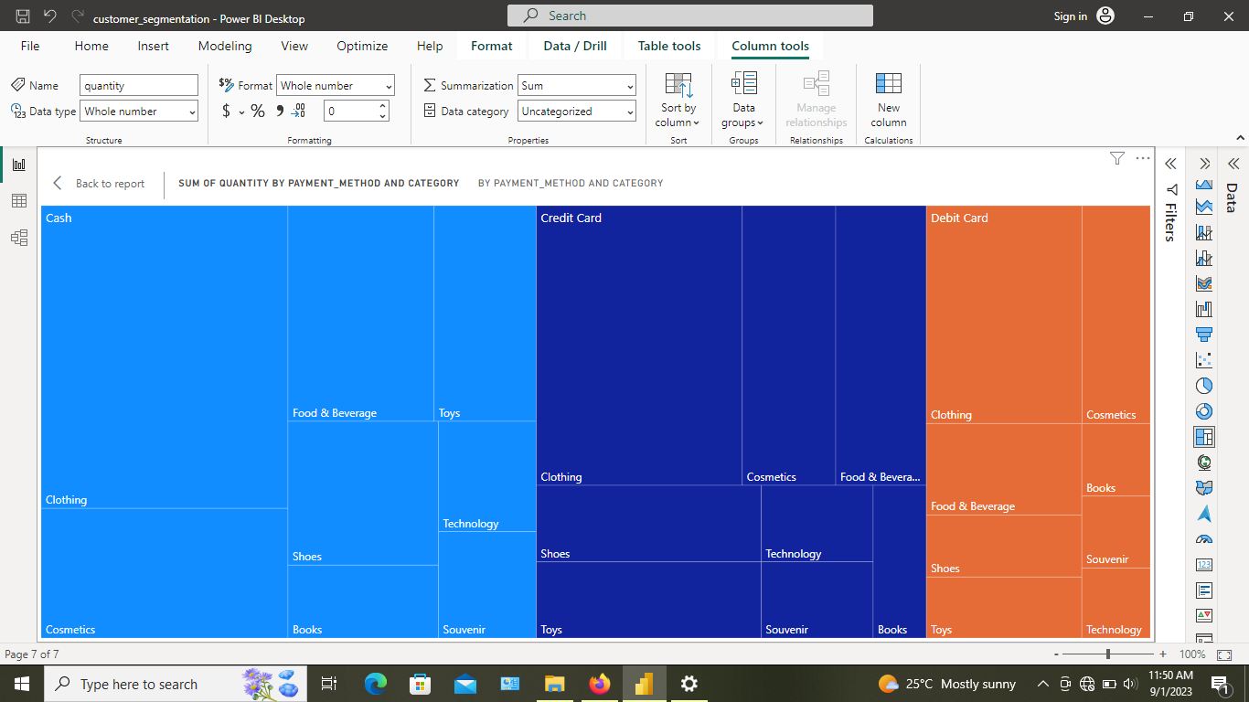
10. How is the distribution of the payment method?

Slide 13
The End. Thank you

